Slide 1
ROLE PLAY G A M E
3D RPG GAME

Slide 2
Introduction
3D role play games have become increasingly popular in the gaming world. With the help of Unity, game developers are able to create immersive, interactive experiences that captivate players. Unity has become a popular platform for 3D role play games due to its powerful engine, easy-to-use tools, and wide range of features.

Slide 3
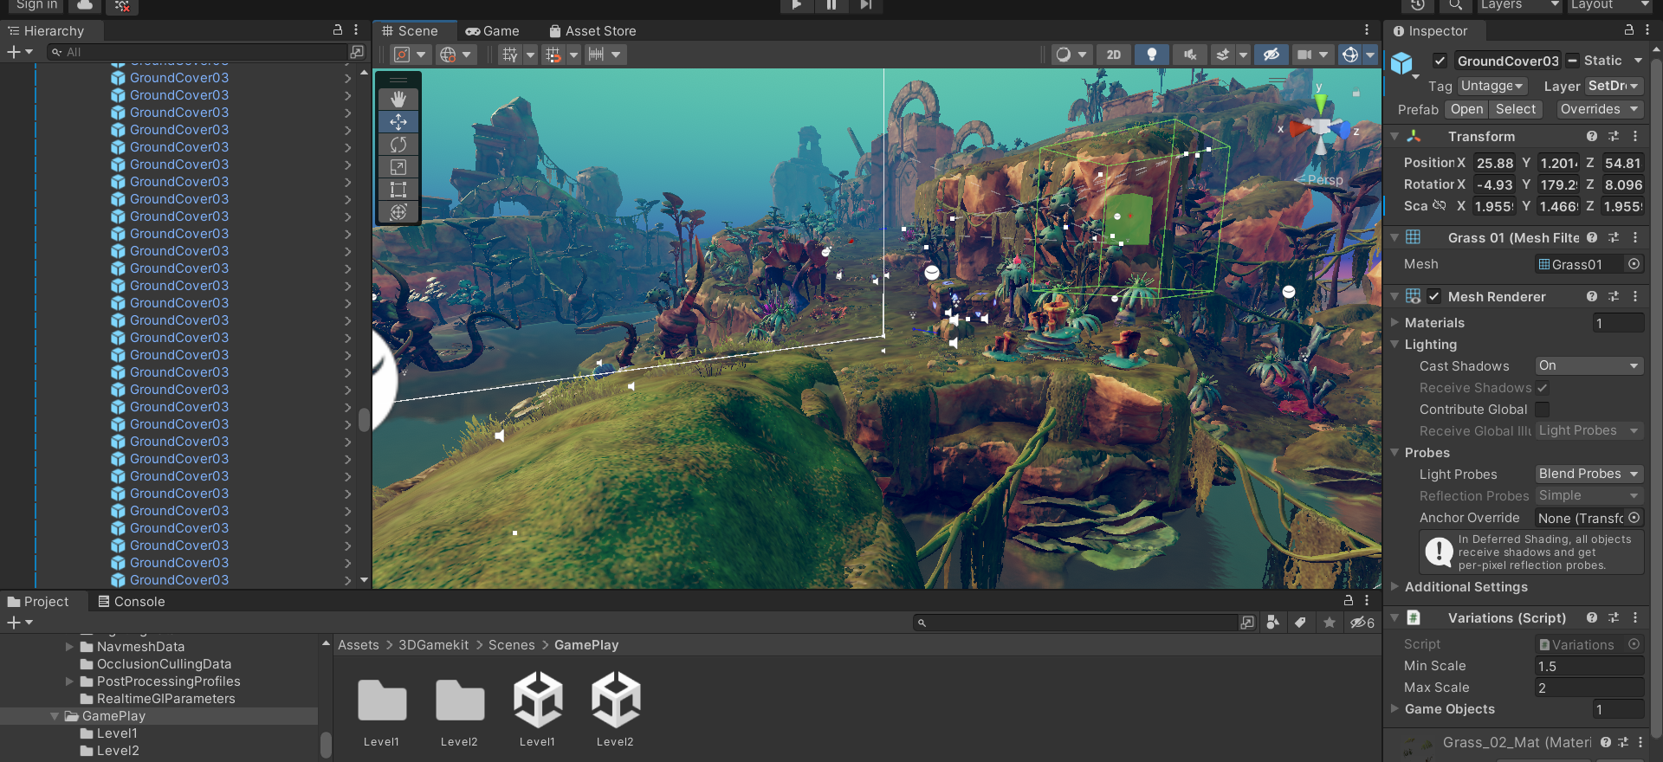
Plane

Slide 4
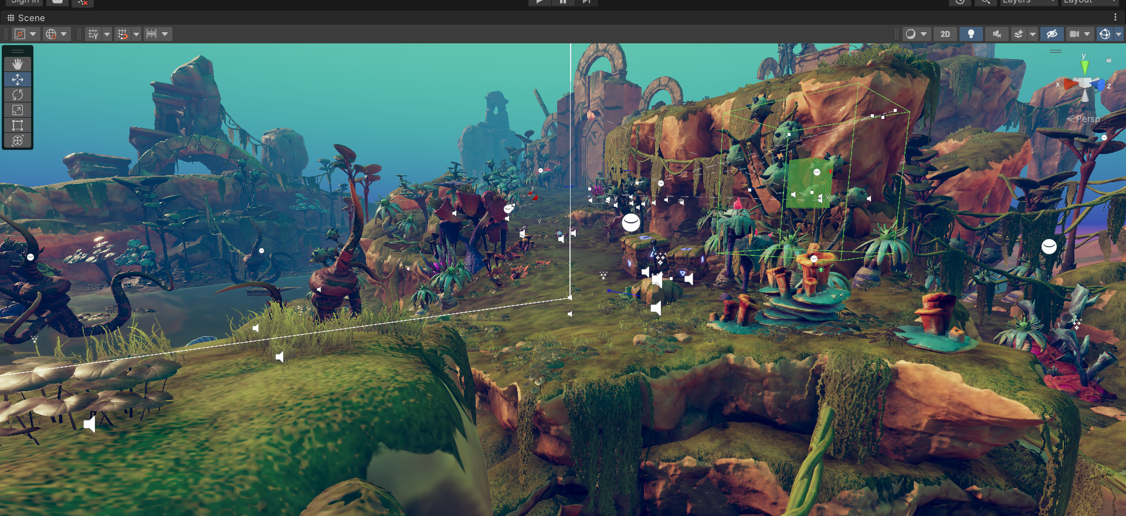
Game view

Slide 5
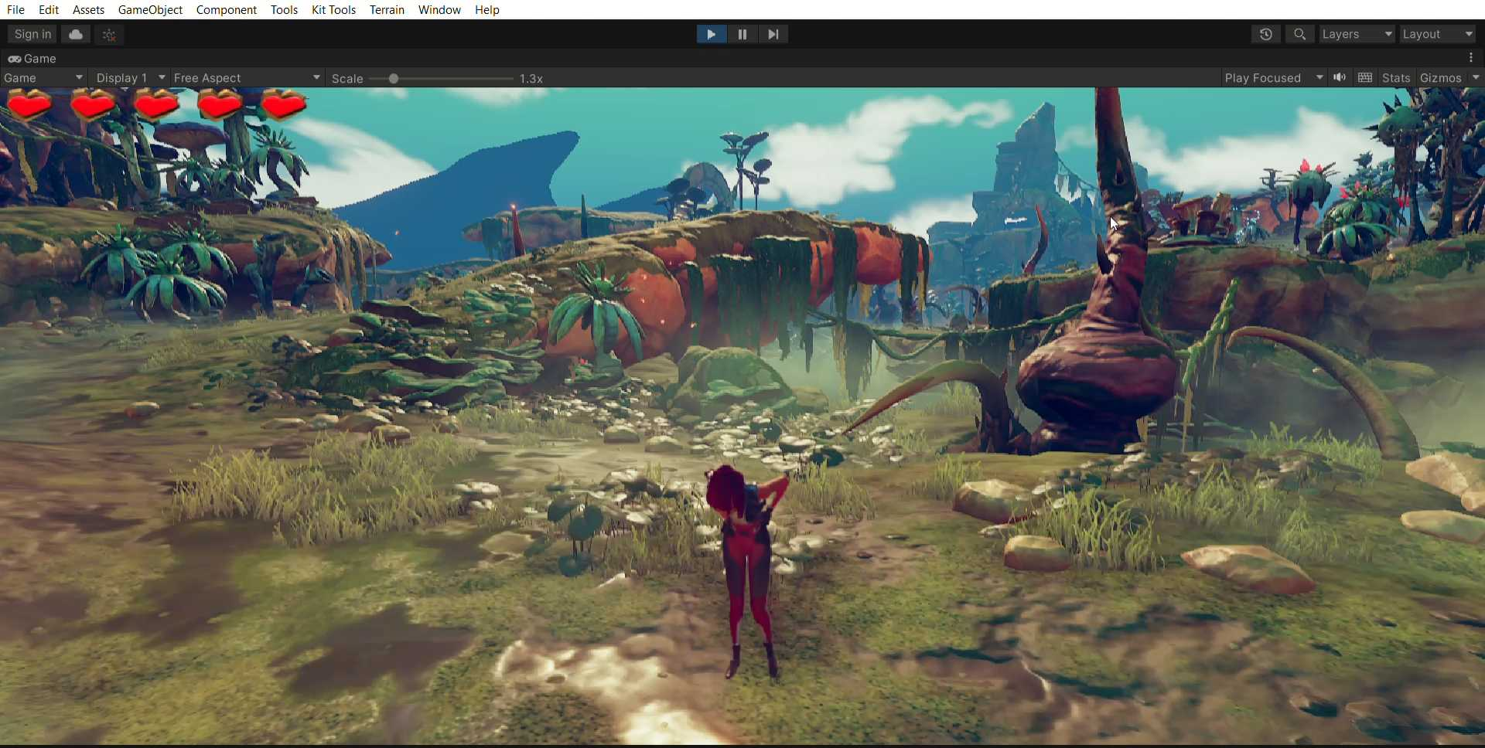
ellen

Slide 6
Player script
using UnityEngine; using Gamekit3D.Message; using System.Collections; using UnityEngine.XR.WSA; namespace Gamekit3D { [RequireComponent(typeof(CharacterController))] [RequireComponent(typeof(Animator))] public class PlayerController : MonoBehaviour, IMessageReceiver { protected static PlayerController s_Instance; public static PlayerController instance { get { return s_Instance; } } public bool respawning { get { return m_Respawning; } } public float maxForwardSpeed = 8f; // How fast Ellen can run. public float gravity = 20f; // How fast Ellen accelerates downwards when airborne. public float jumpSpeed = 10f; // How fast Ellen takes off when jumping. public float minTurnSpeed = 400f; // How fast Ellen turns when moving at maximum speed. public float maxTurnSpeed = 1200f; // How fast Ellen turns when stationary. public float idleTimeout = 5f; // How long before Ellen starts considering random idles. public bool canAttack; // Whether or not Ellen can swing her staff. public CameraSettings cameraSettings; // Reference used to determine the camera's direction. public MeleeWeapon meleeWeapon; // Reference used to (de)activate the staff when attacking. public RandomAudioPlayer footstepPlayer; // Random Audio Players used for various situations. public RandomAudioPlayer hurtAudioPlayer; public RandomAudioPlayer landingPlayer; public RandomAudioPlayer emoteLandingPlayer; public RandomAudioPlayer emoteDeathPlayer; public RandomAudioPlayer emoteAttackPlayer; public RandomAudioPlayer emoteJumpPlayer; } // Called after the animator state has been cached to determine whether this script should block user input.

Slide 7
Player Movement
Ellen's movement is controlled by the EllenController script, which is attached to her game object in the scene. The EllenController script uses Unity's CharacterController component to handle movement and collision detection.
The EllenController script includes several variables that control Ellen's movement speed, jump height, and gravity. The script also includes several functions that handle user input and movement, such as Move() and Jump().
In the Move() function, the script checks for user input and uses the CharacterController component to move Ellen in the desired direction. The script also sets Ellen's movement animation parameter based on her movement direction and speed.

Slide 8
In the Jump() function, the script checks if Ellen is grounded (i.e., standing on a surface) and uses the CharacterController component to apply an upward force to Ellen if she is grounded. The script also sets Ellen's jump animation parameter to trigger the jump animation.
Ellen's movement is also affected by external forces, such as gravity and collisions with other objects. The EllenController script includes functions to handle these events, such as OnControllerColliderHit() to handle collisions with other objects and ApplyGravity() to apply the force of gravity to Ellen's movement.
Overall, Ellen's movement is designed to be responsive and smooth, with a combination of user input and physics-based movement to create a realistic and engaging gameplay experience.

Slide 9
Player Health
using System.Collections; using System.Collections.Generic; using UnityEngine; using UnityEngine.Events; using Gamekit3D.Message; using UnityEngine.Serialization; namespace Gamekit3D { public partial class Damageable : MonoBehaviour { public int maxHitPoints; [Tooltip("Time that this gameObject is invulnerable for, after receiving damage.")] public float invulnerabiltyTime; [Tooltip("The angle from the which that damageable is hitable. Always in the world XZ plane, with the forward being rotate by hitForwardRoation")] [Range(0.0f, 360.0f)] public float hitAngle = 360.0f; [Tooltip("Allow to rotate the world forward vector of the damageable used to define the hitAngle zone")] [Range(0.0f, 360.0f)] [FormerlySerializedAs("hitForwardRoation")] //SHAME! public float hitForwardRotation = 360.0f; public bool isInvulnerable { get; set; } public int currentHitPoints { get; private set; } public UnityEvent OnDeath, OnReceiveDamage, OnHitWhileInvulnerable, OnBecomeVulnerable, OnResetDamage; [Tooltip("When this gameObject is damaged, these other gameObjects are notified.")] [EnforceType(typeof(Message.IMessageReceiver))] public List<MonoBehaviour> onDamageMessageReceivers; protected float m_timeSinceLastHit = 0.0f; protected Collider m_Collider; System.Action schedule; void Start() { ResetDamage(); m_Collider = GetComponent<Collider>(); } void Update() { if (isInvulnerable) { m_timeSinceLastHit += Time.deltaTime; if (m_timeSinceLastHit > invulnerabiltyTime) { m_timeSinceLastHit = 0.0f; isInvulnerable = false; OnBecomeVulnerable.Invoke(); } } }

Slide 10
The code is a script for game objects that can take damage and die.
The script includes variables for maximum hit points, invulnerability time, hit angle, and hit forward rotation.
The script also includes events for when the object dies, receives damage, becomes invulnerable, becomes vulnerable again, and resets damage.
There is a list of message receivers for when the object takes damage, and a collider to detect collisions.
When the object takes damage, the script checks if it is already dead or invulnerable.

Slide 11
If the object is not dead or invulnerable, the script checks the angle and direction of the damage to see if it hits the object.
If the damage hits the object, the script makes the object invulnerable for a set amount of time and decreases its hit points.
If the hit points reach zero or below, the script triggers the OnDeath event.
If the hit points are above zero, the script triggers the OnReceiveDamage event.
There is also a LateUpdate function that runs any scheduled actions, and an OnDrawGizmosSelected function for drawing gizmos in the Unity editor.

Slide 12
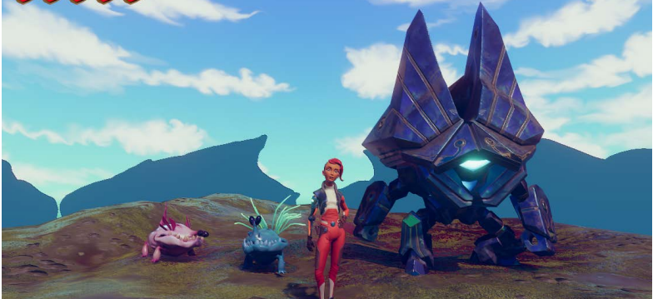
Enemy

Slide 13
Enemy attack system
using System.Collections; using System.Collections.Generic; using System.Security.Cryptography; using UnityEngine; using UnityEngine.AI; namespace Gamekit3D { //this assure it's runned before any behaviour that may use it, as the animator need to be fecthed [DefaultExecutionOrder(-1)] [RequireComponent(typeof(NavMeshAgent))] public class EnemyController : MonoBehaviour { public bool interpolateTurning = false; public bool applyAnimationRotation = false; public Animator animator { get { return m_Animator; } } public Vector3 externalForce { get { return m_ExternalForce; } } public NavMeshAgent navmeshAgent { get { return m_NavMeshAgent; } } public bool followNavmeshAgent { get { return m_FollowNavmeshAgent; } } public bool grounded { get { return m_Grounded; } } protected NavMeshAgent m_NavMeshAgent; protected bool m_FollowNavmeshAgent; protected Animator m_Animator; protected bool m_UnderExternalForce; protected bool m_ExternalForceAddGravity = true; protected Vector3 m_ExternalForce; protected bool m_Grounded; protected Rigidbody m_Rigidbody; const float k_GroundedRayDistance = .8f; void OnEnable() { m_NavMeshAgent = GetComponent<NavMeshAgent>(); m_Animator = GetComponent<Animator>(); m_Animator.updateMode = AnimatorUpdateMode.AnimatePhysics; m_NavMeshAgent.updatePosition = false; m_Rigidbody = GetComponentInChildren<Rigidbody>(); if (m_Rigidbody == null) m_Rigidbody = gameObject.AddComponent<Rigidbody>(); m_Rigidbody.isKinematic = true; m_Rigidbody.useGravity = false; m_Rigidbody.interpolation = RigidbodyInterpolation.Interpolate; m_FollowNavmeshAgent = true; }

Slide 14
The script is used to control the behavior of an enemy in a game.
It includes variables to control the turning behavior of the enemy, as well as whether or not to apply animation rotations.
The script provides access to the animator, NavMeshAgent, and Rigidbody components of the enemy.
The FixedUpdate method is used to update the enemy's grounded state and to apply any external forces that may be acting on the enemy.
The CheckGrounded method uses a raycast to determine if the enemy is on the ground.
The ForceMovement method applies any external forces that have been added to the enemy, taking into account collisions with other objects.

Slide 15
The OnAnimatorMove method is used to move the enemy based on the animation, either by following the NavMeshAgent or by moving the Rigidbody directly.
The SetFollowNavmeshAgent method can be used to disable the NavMeshAgent and allow the animation to move the enemy.
The AddForce method can be used to add an external force to the enemy, such as from an explosion or knockback effect.
The ClearForce method clears any external force that may have been added to the enemy.
The SetForward method can be used to rotate the enemy to face a particular direction.
The SetTarget method can be used to set a new destination for the enemy to move towards using the NavMeshAgent.

Slide 16
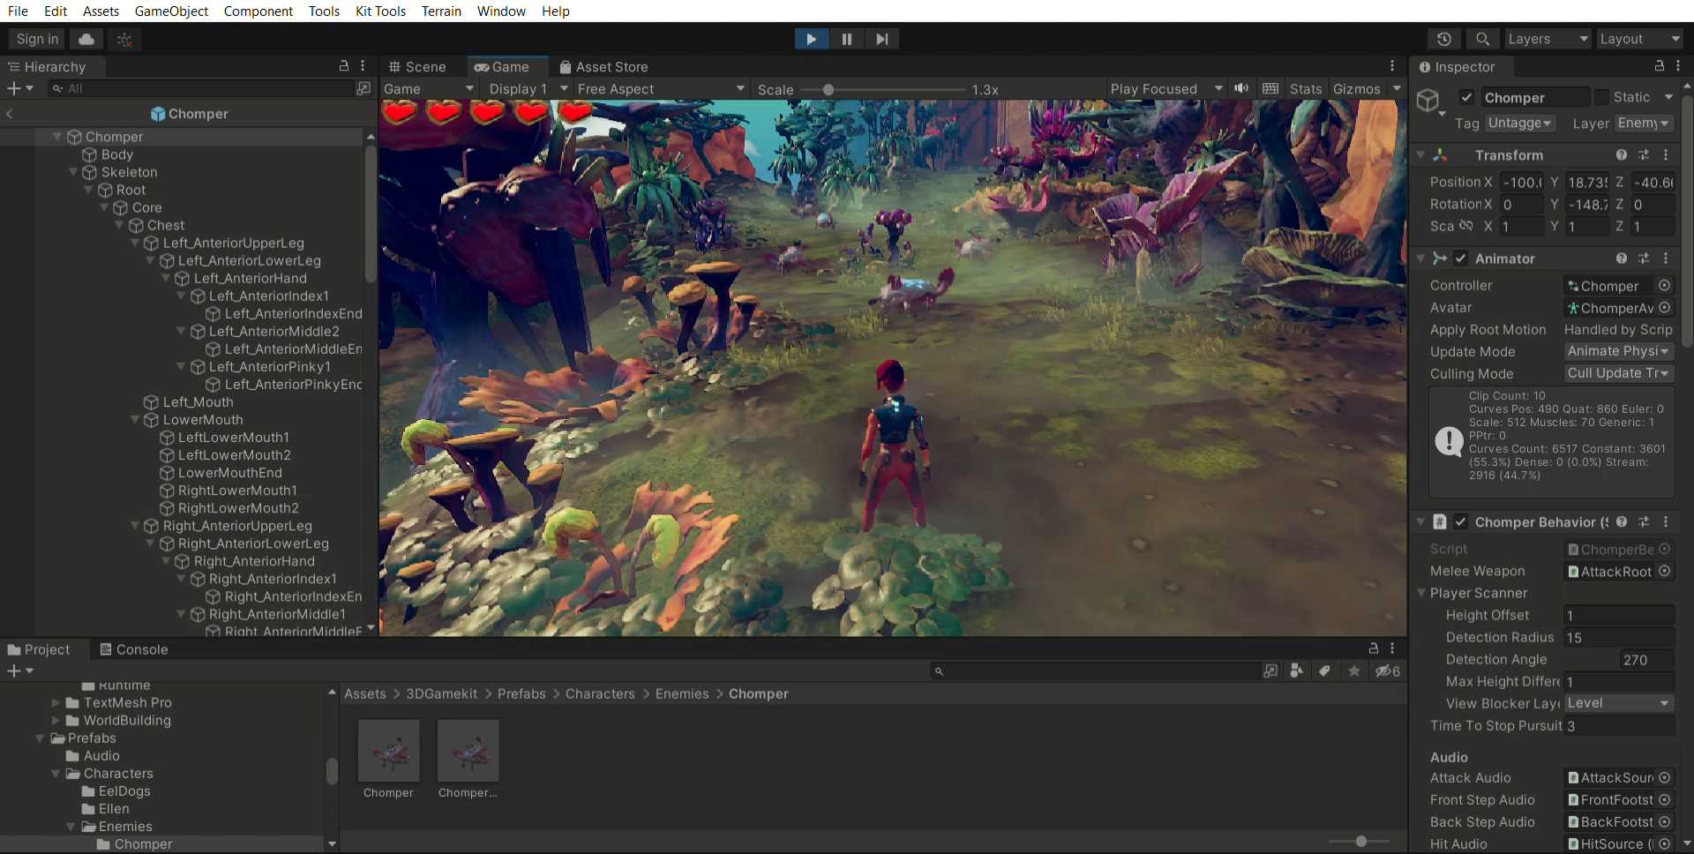
Game play

Slide 17
Conclusion
Unity is a powerful platform for creating 3D role play games. With its suite of tools and features, developers can create immersive, interactive experiences that captivate players. Unity's powerful editor, asset libraries, and physics engine make it easy to create detailed characters, environments, and storylines. With these tools, developers can create a 3D role play game that is engaging and compelling

Slide 18
Our Team
AKHIL P.A
ARJUN V J
ARUN. A
AKASH SAJI
RAKESH M G
PRETHWIDEV KRISHNA

